Slide 1

Autoscaling with VMs
CLOUD PRACTICUM · STREAM 2 OF 2
The same load as stream 1, now on servers you size, boot and scale yourself.
100 minutes
EC2 · Load Balancer · Auto Scaling · k6
Asia Pacific (Jakarta)
Notes:
Welcome back. Last time Lambda scaled itself, per request, in seconds, with nothing to configure. Today we run the same kind of app on EC2 virtual machines behind a load balancer, and an Auto Scaling group decides how many to run. Each box on the right is an instance; the orange one is running, the grey ones are what the group could add. This time every request does real CPU work, and the group scales on CPU. The question for today: what do we have to decide ourselves, and how fast does it react?

Slide 2
Lambda scaled itself, per request
STREAM 1 IN ONE SLIDE
TRIGGER
SPEED
AT THE LIMIT
YOU SET
A busy replica
Seconds
429
Nothing
A request with no idle replica started a new one
About 2 s of startup per new replica
Extra requests rejected at once
No metric, no policy to scale out
Today: the same load on VMs, where each of these becomes your decision.
Autoscaling with VMs · Stream 2
02
Notes:
Ask the class to recall stream 1 before revealing: what made Lambda add a replica, how fast, what happened at the limit, and what did we configure? Answers: a request with no idle replica; seconds; 429 at once; nothing to scale out. Keep these four in mind; the debrief compares each one with the VM setup.

Slide 3
100 minutes, four experiments
AGENDA
Minutes | Segment | Mode
0–8 | Recap of stream 1, and today’s question | Lecture
8–38 | Part 1: build the five pieces | Follow along
38–46 | How Auto Scaling decides | Lecture
46–52 | Exp 1 · One instance vs a burst | Hands-on
52–78 | Exp 2 · Step load, short and long | Hands-on
78–85 | Exp 3 · Pre-warmed instances | Hands-on
85–91 | Exp 4 · Hitting the ceiling | Hands-on
91–96 | Debrief: Lambda vs VMs | Discussion
96–100 | Cleanup | Hands-on
Autoscaling with VMs · Stream 2
03
Notes:
Part 1 is longer than in stream 1: five pieces instead of one function. Experiment 2 takes about 26 minutes because the long step needs time for the group to react; use the waiting time inside it for the quiz and discussion. Experiment 5, the wrong metric, is a take-home. Cleanup is not optional today: the load balancer and instances are billed by the hour.

Slide 4



Five pieces behind one URL
PART 1 · 8–38 MIN
Auto Scaling group · min 1, max 6
k6
Load balancer
Target group
Instance · 2 vCPUs · running
your laptop
scale-alb
scale-web-tg
Instance · added when needed
Instance · added when needed
CPU reported every minute
Metric
Alarm
Target tracking policy
average CPU of the instances
AlarmHigh · AlarmLow
Keeps average CPU near 50%
Notes:
Walk the request path first, left to right on the top row: k6 sends to one public URL, the load balancer spreads requests over the target group, and the target group holds whatever instances are running. Then the control loop on the bottom row: each instance reports its CPU every minute (with detailed monitoring on), an alarm watches the group’s average, and the target tracking policy changes the group’s desired capacity to keep it near 50 percent. Point out that Lambda had all of this built in and invisible. The two security groups are not drawn: one lets the internet reach the load balancer, the other lets only the load balancer reach the instances. The launch template is the recipe each new instance is built from.

Slide 5
Every request burns real CPU
THE APP · INSIDE USER-DATA.SH
100k–200k hashes
def burn(iterations): # runs in a worker process
A random count of SHA-256 rounds per request, about 0.1 s of CPU on average
for _ in range(iterations):
h = hashlib.sha256(h).digest()
iterations = random.randint(lo, hi) # ?min= &max=
1 worker per vCPU
if not slots.acquire(timeout=2): # all CPUs busy
return self.send_json(503, ...)
A t3.micro has 2; extra requests queue up to 2 s
cpu_ms = pool.submit(burn, iterations).result()
Then 503
One instance serves about 20 requests per second at 100% CPU, or 10 per second at 50%.
Like a real overloaded web server
Autoscaling with VMs · Stream 2
05
Notes:
Unlike the Lambda app, which only waited, this app does real work: each request runs SHA-256 on its own result a random number of times, between min and max, 100,000 to 200,000 by default. Random amounts make requests uneven, like real pages. On a t3.micro that averages roughly 0.1 seconds of CPU, but it depends on the processor, so students measure it with the k6 warm run in Step 6: WHAT HAPPENED prints the average cpu_ms and the requests per second one instance can serve. The app runs one worker process per vCPU, two on a t3.micro, so one instance can do 2 CPU-seconds of work per second: about 20 requests per second at full CPU, or 10 per second at 50%. When both workers are busy, requests queue; after 2 seconds without a free worker the app answers 503. k6 now paces each user to about one request per second, like a real person, so 10 users mean about 10 requests per second and 50% CPU on one instance. The full app is in user-data.sh in the guide; it also returns instance_id, iterations, cpu_ms, waited_ms and a health check on /health. If the measured average is far from 100 ms, scale the predictions: at 150 ms, one instance at 50 percent handles about 7 users instead of 10.

Slide 6
Build them in this order
PART 1 · BUILD ORDER
# | Piece | Name | Its job
1 | Security groups | scale-alb-sg, scale-web-sg | Internet reaches the load balancer; only the load balancer reaches instances
2 | Launch template | scale-web-lt | Recipe for a new instance: OS, size, firewall, user-data.sh
3 | Target group | scale-web-tg | The instances that get traffic, and their health check
4 | Load balancer | scale-alb | One public URL that spreads requests over the target group
5 | Auto Scaling group | scale-web-asg | Runs 1 to 6 instances and follows the scaling policy
Keep the names exactly as written: every CLI command in the guide finds the pieces by name.
Autoscaling with VMs · Stream 2
06
Notes:
Each piece is used by the next, which is why the order matters and why cleanup goes in reverse. Students can mix console and CLI freely: every CLI command in the guide looks the pieces up by name, so the names must match exactly. Common slips: creating the Auto Scaling group in a different VPC from the target group (the target group then does not show up in the list), and forgetting that the list in step 5 shows target groups, not load balancers. Checkpoint after step 5: wait 2–3 minutes, see one healthy target, open the URL and get an instance_id starting with i-.

Slide 7
The settings to get right
PART 1 · SETTINGS THAT MATTER
Launch template
Target group
Amazon Linux 2023, x86, t3.micro (2 vCPUs)
Detailed monitoring on: CPU every minute
scale-web-sg, no key pair, user-data.sh
Instances, HTTP 80, default VPC
Health check /health every 10 s, 2 to be healthy
Deregistration delay 30 s (Attributes tab)
Load balancer
Auto Scaling group
Internet-facing, every Availability Zone
Security group scale-alb-sg only
HTTP 80 forwards to scale-web-tg
Min 1, desired 1, max 6, same VPC as the target group
Load balancer health checks, grace 60 s, warmup 60 s
Group metrics on, target tracking: CPU 50%
Autoscaling with VMs · Stream 2
07
Notes:
The full click path is in the guide; these are the settings that break the experiment if missed. Detailed monitoring in the launch template: without it EC2 reports CPU only every 5 minutes and the CPU policy reacts far later. Deregistration delay: the default 300 seconds makes scale-in look much slower than it is. Load balancer health checks on the group: otherwise a broken instance stays in service. Group metrics: without them the CloudWatch graph of instances stays empty. Warmup 60 seconds: new instances are not counted in the metric until warmed up. Same VPC for group and target group, or the target group will not appear in the list.

Slide 8
Keep average CPU near 50%
HOW AUTO SCALING DECIDES · 38–46 MIN
10 users · 1 CPU-s/s
30 users · 3 CPU-s/s
60 users · 6 CPU-s/s
1
3
6
instance
instances
instances, the maximum
One instance at 50% = 2 vCPUs × 50% = 1 CPU-second per second = 10 users × about 0.1 s. The other 50% is headroom while new instances boot.
Autoscaling with VMs · Stream 2
08
Notes:
Target tracking keeps one metric near a value you choose. We track average CPU utilization across the group, target 50 percent, the most common real-world setup. Work it out with the class: each user sends one request per second, each request costs about 0.1 CPU-seconds on average (100,000 to 200,000 random hashes), so 10 users need 1 CPU-second per second, which is exactly 50 percent of one t3.micro. 30 users need 3 instances, 60 users need 6, our maximum. Compare with Lambda’s formula, replicas ≈ requests per second × busy time: same idea, but here you chose the metric and the target. Why not 90 percent? Fewer instances, but no headroom while new ones boot; that is Experiment 5. Why not 20 percent? Plenty of headroom, but you pay for mostly idle machines.

Slide 9

Five steps before a new instance helps
HOW AUTO SCALING DECIDES
01
02
03
04
05
Measure
Alarm
Decide
Boot
Healthy
Average CPU of the group, per minute
AlarmHigh: over 50% for several minutes in a row
The policy raises desired capacity
The instance starts and runs user-data.sh
2 health checks pass, then it gets traffic
1–2 min late
seconds
a few min
1–2 min
about 20 s
Add them up: minutes, not seconds. Removing instances is slower still. Lambda went from request to new replica in about 2 s.
Autoscaling with VMs · Stream 2 · Rough times; measure yours in Experiment 2b
09
Notes:
This is the slide that explains every result today. A new instance only helps after five things happen. The instances report CPU once a minute (only with detailed monitoring; basic monitoring is every 5 minutes), and the data arrives late. The AlarmHigh alarm waits until the metric has been over the target for several datapoints in a row, so a short spike does not trigger it. Then the policy raises desired capacity, the instance boots and runs user data, and finally the target group needs two passing health checks 10 seconds apart. The times on the slide are rough. Ask students to open the two TargetTracking alarms in CloudWatch, read how many minutes each one needs before it fires, and compare with what they measure in Experiment 2b. AlarmLow needs many more minutes than AlarmHigh: AWS removes instances cautiously so it does not drop capacity during a short dip.

Slide 10



Three places to watch
HOW WE MEASURE
Activity tab
CloudWatch graph
k6 summary
Exact start and end time of every launch, and its cause.
Desired vs in-service instances, and average CPU.
WHAT HAPPENED explains every status code.
EC2 → Auto Scaling Groups → scale-web-asg → Activity
The gap between desired and in service is the boot time.
wait_ms shows how long requests queued for a worker.
Autoscaling with VMs · Stream 2
10
Notes:
Logs Insights from stream 1 is not needed today. The Activity tab is the stopwatch: note when k6 raised the load and when the new instance’s launch ended, then add the time to become healthy in the target group. The CloudWatch graph shows GroupDesiredCapacity, GroupInServiceInstances (both Maximum, 1-minute period) and the group’s CPUUtilization (Average, under EC2 By Auto Scaling Group) on the right axis; metrics arrive 1–2 minutes late. The k6 script now ends with a WHAT HAPPENED section that counts each status code and explains it, and wait_ms shows queueing on the instances.

Slide 11
One instance vs a burst of 30
EXPERIMENT 1 · 46–52 MIN
EXPECT
DEMAND VS CAPACITY, REQUESTS PER SECOND
100%
1
30 users, 1 request per second each
30
CPU on the instance
instance the whole time
1 instance at 100% CPU (2 vCPUs ÷ about 0.1 s)
~1 s
Few
20
queue wait, worst cases
503s, if any
The other 10 per second wait in the queue, so every request slows down.
Ask: Lambda started 30 replicas for this. Why did nothing new start here?
k6 run -e URL=$URL -e SCENARIO=burst -e VUS=30 \
-e MIN=100000 -e MAX=200000 k6.js
Autoscaling with VMs · Stream 2 · Expected values from the app’s capacity; measure yours
11
Notes:
Predict first: 30 users, each sending one request per second, against one instance. The instance can do 2 CPU-seconds per second, and each request costs about 0.1 on average (the warm run in Step 6 gives your real figure), so it serves about 20 requests per second at 100 percent CPU. The other 10 per second queue, so waits grow; in a local test of the app, about 1.4 seconds was the worst queue for 30 waiting users, under the 2-second limit, so expect few or no 503s. The burst lasts only a few seconds, far shorter than the minute-level CPU metric and the alarm, so the Auto Scaling group never reacts. Compare with stream 1 Experiment 1b, where Lambda started a replica per request within seconds. The numbers on this slide are expectations from the app’s capacity, not a measurement on AWS.

Slide 12
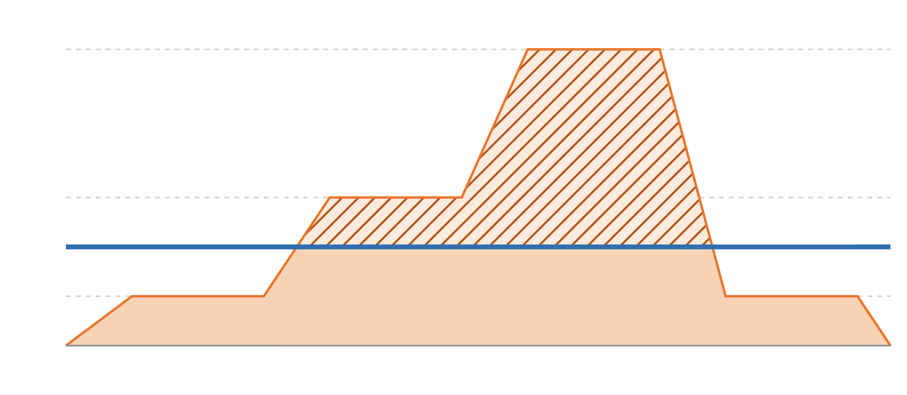

Over before the group reacts
EXPERIMENT 2A · A SHORT STEP, 4.5 MIN
EXPECT
60
10 users: CPU about 50%
30 users: CPU 100%, queueing
60 users: many 503s
No new instance during the run
30
Each level lasts under a minute. The alarm needs several.
20
10
k6 run -e URL=$URL \
0
-e SCENARIO=step \
0 s
120 s
240 s
-e MIN=100000 -e MAX=200000 k6.js
Load: k6 users
1 instance at full CPU (≈ 20 users)
Queued or 503
Autoscaling with VMs · Stream 2 · Chart: expected shape, not a measurement
12
Notes:
Lambda would follow this load within seconds, about one replica per user. Here the blue line is one instance at full CPU, about 20 users. At 10 users CPU sits near the 50 percent target; at 30 users it is pinned at 100 percent and requests queue; at 60 users the queue passes 2 seconds and many requests get 503. Each level lasts 40 to 60 seconds, while the CPU metric is per minute, arrives late, and the alarm needs several minutes above target, so no instance arrives during the run. Ask students to check the Activity tab a few minutes after the test: an instance may arrive after the load has already dropped.

Slide 13
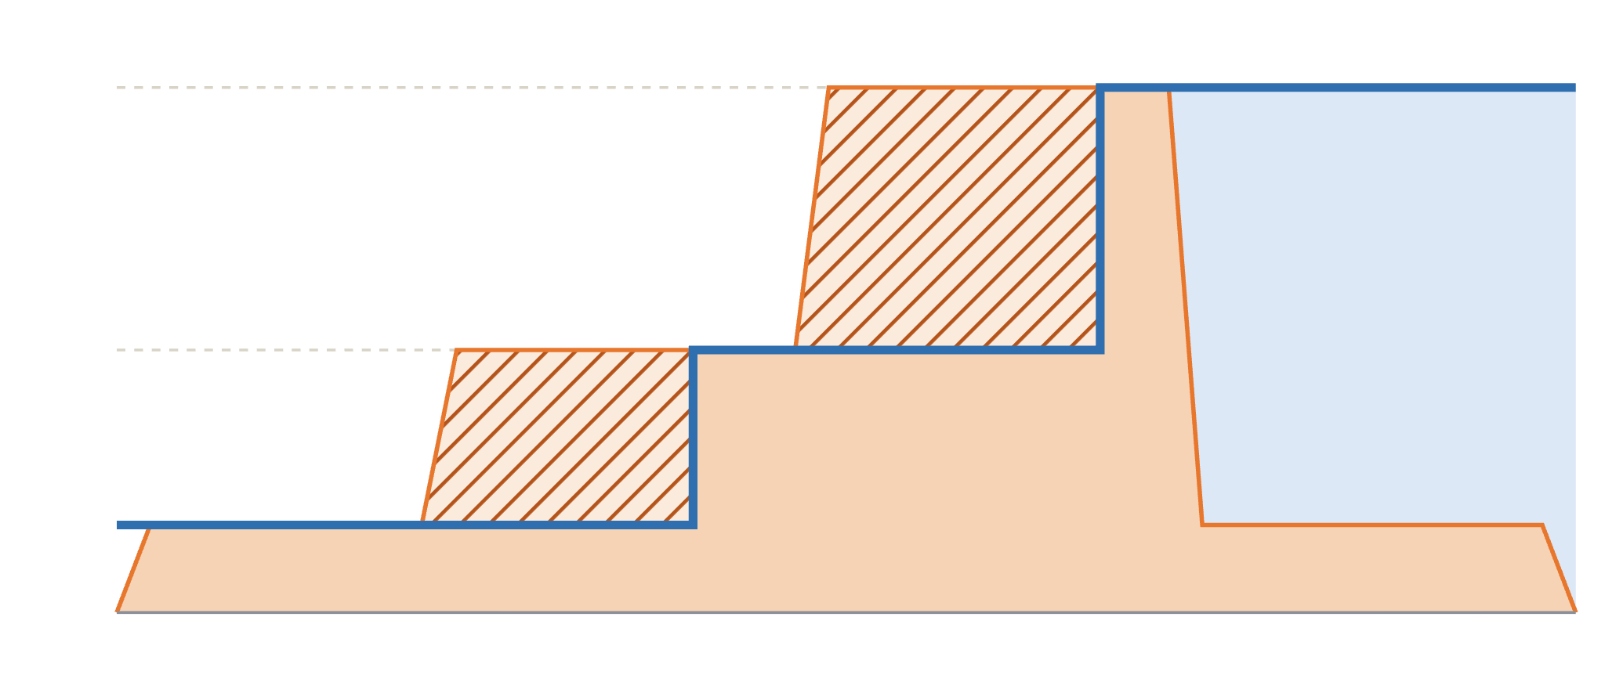
Instances follow, minutes behind
EXPERIMENT 2B · LONG STEP, ABOUT 21.5 MIN
Measure
60
Scale-out time for each step up
Scale-in time after the drop
503s while instances boot
lag
idle
30
K6_WEB_DASHBOARD=true \
k6 run -e URL=$URL \
-e SCENARIO=steplong \
10
-e MIN=100000 -e MAX=200000 k6.js
0
0
5 min
10 min
15 min
20 min
Load: k6 users
Instances × 10 users (50% CPU)
Over target: hot CPU, queueing
Idle, still paid for
Autoscaling with VMs · Stream 2 · Illustrative shape: the delays depend on your alarms, so measure them
13
Notes:
Each level now lasts 4 to 5 minutes, long enough for the alarm, the boot and the health checks. The chart is an illustration of the shape to expect, not a measurement: the blue line, instances times 10 users at the 50 percent target, climbs to 3 and then 6 instances, but some minutes after each rise. In the hatched gaps CPU runs above target; once it passes 100 percent, users queue or get 503 until the new instances are healthy. When the load drops back to 10 users, the extra instances stay for a long time, shown in light blue: idle capacity you still pay for. Students record their real scale-out and scale-in times and compare them with the AlarmHigh and AlarmLow settings they wrote down in Part 1. Use this 21-minute run for the quiz and for discussion. Before starting, note how many instances 2a left running.

Slide 14
Pre-warmed instances
EXPERIMENT 3 · 78–85 MIN
Run | Ready | Users | Expect
Exp 1 | 1 instance | 30 | CPU 100%, requests queue
3a | 6 instances | 60 | CPU about 50%, no queue
3b | 6 instances | 200 | Past 120/s: queue, some 503
1 · Raise the minimum
Min 6, desired 6. Wait for 6 healthy targets (3–4 min).
2 · Run
Burst of 60 users (3a), then 200 (3b).
The VM version of Provisioned Concurrency: capacity ready before the crowd arrives.
3 · Set it back
Min 1, desired 1. Extra instances are removed right away.
Six instances all day cost six times one.
Autoscaling with VMs · Stream 2
14
Notes:
Can we avoid the wait by starting instances before the traffic comes? Raise minimum and desired capacity. Console: Auto Scaling Groups, scale-web-asg, Details, Group details, Edit, desired 6, min 6, max 6. CLI: aws autoscaling update-auto-scaling-group --auto-scaling-group-name scale-web-asg --min-size 6 --desired-capacity 6. Wait until the target group shows six healthy targets. Then burst 60 users: six instances can serve about 120 requests per second at full CPU, so 60 users run them at about 50 percent with no queue. Burst 200: more than six instances can serve, so requests queue and some get 503, just like Lambda’s spillover past Provisioned Concurrency. Set it back to min 1, desired 1: lowering desired removes instances right away, unlike the slow policy-driven scale-in in Experiment 2b. Ask: you know a peak comes every day at 9 AM; what would you do? A scheduled action that raises the minimum before 9 and lowers it after.

Slide 15

Hitting the ceiling
EXPERIMENT 4 · 85–91 MIN
Steps
MAX 2 INSTANCES ≈ 40 REQUESTS/S · 120 USERS
Min, desired and max all 2
Wait for 2 healthy targets
Run the burst of 120
Set back: min 1, max 6
40/s
served at 100% CPU
80/s
Bonus: set all three to 0, then curl the URL. That 503 comes from the load balancer itself.
wait up to 2 s, then many get 503
Each square = 2 users
k6 run -e URL=$URL -e SCENARIO=burst -e VUS=120 \
-e MIN=100000 -e MAX=200000 k6.js
Autoscaling with VMs · Stream 2
15
Notes:
Maximum capacity is the VM version of reserved concurrency. To save time, start at the ceiling: CLI aws autoscaling update-auto-scaling-group --auto-scaling-group-name scale-web-asg --min-size 2 --max-size 2 --desired-capacity 2. Two instances have 4 vCPUs, about 40 requests per second at full CPU. With 120 users sending about 120 per second, CPU pins at 100 percent and the rest queue; anyone who waits more than 2 seconds gets 503 from the app. In the Activity tab, students can see whether the policy even tried to add instances: it cannot go past the maximum. Bonus: set min, desired and max to 0, wait until no targets are registered and run curl -i on the URL: now the 503 comes from the load balancer, because it has no instance to send to. Set it back to min 1, desired 1, max 6. Ask: why would anyone set a low maximum on purpose? To cap cost or protect a database behind the app.

Slide 16
Two ways to say no
429 VS 503
429
503
Lambda · stream 1
VMs · today
Rejected in milliseconds, before your code runs. No waiting.
From the app after waiting up to 2 s for a free CPU, or at once from the load balancer with no instance.
Same cause: capacity did not arrive in time. Which is kinder to a user: a fast no, or a slow no?
Autoscaling with VMs · Stream 2
16
Notes:
Put the two errors side by side. Lambda’s 429 comes from the platform: it refuses before running your code, so the client hears no in milliseconds. Today’s 503 comes in two flavours. Most of the time it is our app on the instance: both CPU workers (one per vCPU) stayed busy for 2 seconds, so it gave up. In the Experiment 4 bonus it came from the load balancer itself, because no instance was registered. Note that if instances are registered but all failing health checks, the load balancer still sends them traffic rather than answering 503 itself. Requests stuck too long on an instance would show up as 504. Discussion: a fast rejection lets the client retry or show a message quickly; a slow one ties up the user and the client’s connections.

Slide 17
A target set too high
EXPERIMENT 5 · TAKE-HOME
Raise the CPU target from 50% to 90%, run the long step, compare with Experiment 2b, then set it back.
INSTANCES
HEADROOM
USERS
Fewer
Almost none
Wait longer
Each one may run up to 90% before help comes
A burst hits 100% CPU while new instances boot
More queueing, and 503s at each step up
Ask: how many instances did 90% save, and what did users pay for it?
Autoscaling with VMs · Stream 2 · Expected outcome; students measure it
17
Notes:
Take-home, steps in the guide: edit the cpu-target policy to 90, run the long step, record instances, highest CPU, wait_ms and 503s, then set it back to 50. A higher target is cheaper because each instance is allowed to work harder before another is added. The price is headroom: when the load steps up, instances hit 100 percent right away, requests queue and some get 503 until the new instance boots and becomes healthy. Discuss why a nearly full instance slows every request, not just the extra ones: they all share the same queue. Lambda had no target to choose: an advantage for simplicity, a limitation when you want to trade cost against speed.

Slide 18
Lambda vs VMs, side by side
DEBRIEF · 91–96 MIN
Question | Lambda (stream 1) | VM + Auto Scaling (today)
Scaling unit | A replica, 1 request at a time | An instance with 2 vCPUs of work
Trigger | A request with no idle replica | Average CPU above your target for several minutes
Speed | Seconds | Minutes: alarm, boot, health checks
Limit | Reserved or account concurrency | Max capacity
Past the limit | 429, at once | 503, after waiting
Scale in | Idle replicas reclaimed | Slowly by policy, or at once if you lower desired
You configure | Nothing to scale out | Template, target group, load balancer, group, policy, min, max
Autoscaling with VMs · Stream 2
18
Notes:
Have groups fill the VM column in their results sheet first, then reveal this slide. Each row maps to an experiment: unit and speed from Experiments 1 and 2, limit and the 503 from Experiment 4, scale-in from 2b and 3, and the configuration from Part 1. Then turn it around: what does the VM setup give you that Lambda does not? Control over instance size, long-running work, steady costs at constant load, and the choice of metric. Lambda wins on spiky, short, unpredictable traffic with nothing to tune.

Slide 19
Check yourself
QUIZ · DURING THE LONG STEP
Q1
Q2
2 instances average 90% CPU and the target is 50%. About how many instances does the policy want?
Why did Experiment 2a add no instance before the test ended?
Q3
Q4
5,000 users arrive at 9 AM every day. Which setting helps, and what does it cost?
Why does a 90% CPU target make users wait longer at each step up?
Autoscaling with VMs · Stream 2
19
Notes:
Use the waiting time in Experiment 2b. Answers. Q1: about four. Two instances at 90 percent do the work of 3.6 instances at 50 percent, so the policy rounds up to 4. Q2: each level lasted under a minute, while the metric is per minute, arrives late, and the alarm needs several minutes above target; then the instance still has to boot and pass health checks. Q3: raise the minimum capacity before 9 AM, for example with a scheduled action, so instances are booted and healthy before the crowd; the cost is paying for those instances while they wait, so lower the minimum again afterwards. Q4: at 90 percent there is almost no headroom; when the load steps up, instances hit 100 percent at once and requests queue or get 503 for the minutes it takes to add and boot new instances.

Slide 20


Clean up, in this order
BEFORE YOU LEAVE · 96–100 MIN
The load balancer and every instance are billed by the hour, even with no traffic.
1
2
3
4
5
Auto Scaling group
Load balancer
Target group
Launch template
Security groups
Terminates instances, removes policy and alarms
scale-alb
scale-web-tg, after the load balancer is gone
scale-web-lt
scale-web-sg first, then scale-alb-sg
Finally: CloudWatch → Alarms shows no TargetTracking-scale-web-asg alarms.
Autoscaling with VMs · Stream 2
20
Notes:
Reverse order of building, because each piece is used by the next. Deleting the Auto Scaling group terminates its instances and removes the scaling policy and its alarms; wait until the instances show as terminated. Then the load balancer, then the target group, which cannot be deleted while a load balancer still uses it. Then the launch template. Security groups last: the instance group first, then the load balancer group; if one says it is still in use, wait a minute and retry. The CLI versions in the guide find everything by name, so they work however students built it. Walk the room and check before anyone leaves.

Slide 21
Autoscaling is a set of choices
THE TAKEAWAY
Lambda made most of them for you. VMs hand every one of them to you.
Pick the right metric
Plan for the delay
Set limits on purpose
Scale on what users actually wait for
Pre-warm before known peaks
To cap cost and protect what sits behind you
Notes:
Close with the big idea from both streams. Every autoscaler answers the same questions: what triggers it, how fast it reacts, where it stops, and what users get past that point. Lambda answered most of them for us; with VMs we answered each one ourselves, and saw what happens when an answer is slow or wrong. Remind students that the reflection questions for the lab report are at the end of the guide, and confirm everyone has cleaned up.

